Slide 1


Students' Perceptions and Insights on AI in Education
The rapid integration of Artificial Intelligence (AI) is reshaping education, affecting learning, teaching, and administration. Understanding students' perceptions is vital to ensure AI meets their needs and gains acceptance. The Faculty of Cybernetics, Statistics, and Economic Informatics conducted research to assess how future digital professionals view AI's role, benefits, and risks in academia.
John Mwangi Megwe
Zindua Coding School
Notes:
1

Slide 2

Research Focus and Target Audience
Problem Statement
Lack of empirical data on students' attitudes toward AI risks ineffective AI deployment and mistrust in education.
Target Audience
University administration and faculty
EdTech companies and AI developers
Policymakers in education and technology
Academic researchers and think tanks
Student career services
Notes:
2

Slide 3
Research Questions and Background
Key Research Questions
Background
AI enables adaptive learning, personalized feedback, and administrative automation. Its integration in Romania surged post-2010, especially in technical universities.
Key concerns include dehumanization, job displacement, and over-reliance on technology. Ethical gaps risk exacerbating inequality and undermining trust in education.
Sustainable AI must align with learners’ needs and institutional values. Prioritizing ethics ensures equitable access and long-term acceptance.
Students’ AI Knowledge & Learning Sources
Attitudes on AI’s Societal & Economic Impact
Emotional Associations with AI
Key Sectors Affected by AI
AI’s Role in Job Loss vs. Economic Growth
Perceived Usefulness of AI in Education
Advantages & Risks of AI in Learning
Notes:
3

Slide 4
Methodology: Data Collection and Analysis
Data Collection
Data Analysis
Dashboard
Online survey with 91 second- and third-year undergraduates from Cybernetics faculty.
Responses recoded into numerical scales; Excel used for pivot tables and visualizations including bar and donut charts.
Comprehensive Excel dashboard created for clear, color-coded visual storytelling of findings.
Notes:
4

Slide 5
Students' AI Knowledge and Information Sources
Knowledge Level
Most students rated their AI knowledge between 5 and 8, indicating moderate familiarity.
Information Sources
Internet: 44%
Scientific books and papers: 19%
Social media: 24%
Family and friends: 11%
Notes:
5

Slide 6
Attitudes Toward AI’s Societal and Economic Effects
Societal Effects
66% agree AI aids problem-solving; 35% fear job replacement; low fear of AI ruling society.
Economic Impacts
36% fully agree AI drives economic growth; moderate concern about job loss; low fear of economic crisis.
Notes:
6

Slide 7
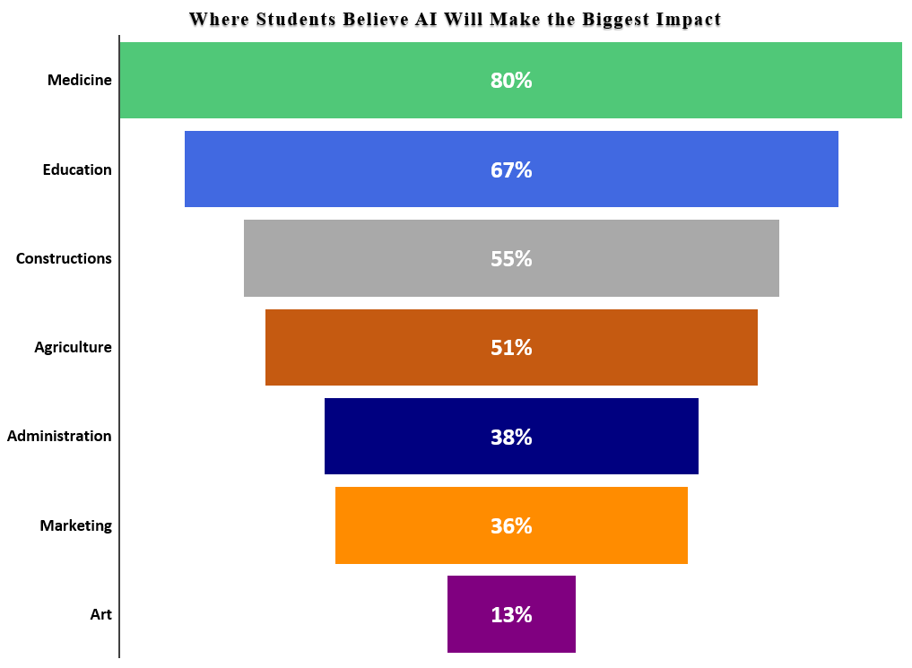
Emotional Responses and Expected AI Impact Sectors
Emotions Toward AI
Curiosity and trust dominate; fear and indifference are minimal.
Top Impact Sectors
Medicine: 80%
Education: 67%
Construction: 55%
Agriculture: 51%
Artistic fields: 13%
Notes:
7

Slide 8
Perceived Usefulness and Advantages of AI in Education
Usefulness Ratings
23% rated AI usefulness in education as 10/10; most ratings between 7 and 10.
Advantages
Teaching: 43% favor AI assistants for managing classes
Learning: 53% highlight universal access
Evaluation: 50% prefer constant feedback
Notes:
8

Slide 9
Perceived Disadvantages and Correlation Between Knowledge and Usefulness
Main Disadvantage
37% cite loss of student-teacher bond; concerns about internet addiction and reduced interaction.
Correlation
Higher AI knowledge correlates with greater perceived usefulness, highlighting the value of AI literacy education.
Notes:
9

Slide 10
Conclusion and Recommendations for AI in Education
Conclusion
Recommendations
Students show moderate to high AI awareness, cautious optimism, and value AI’s educational benefits if ethical and relational aspects are preserved.
Enhance AI literacy through education programs
Preserve student-teacher relationships with hybrid AI models
Design inclusive, accessible student-centered AI tools
Implement ethical policies ensuring transparency and privacy
Collect continuous student feedback on AI tools
Notes:
10

